Slide 1
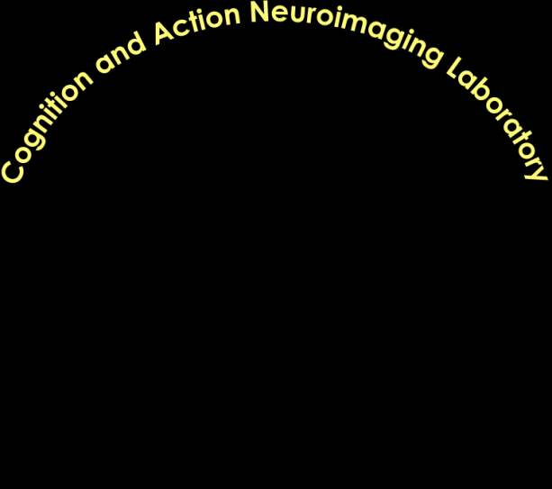
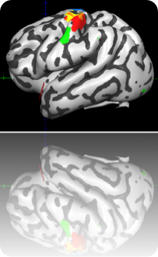
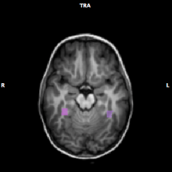
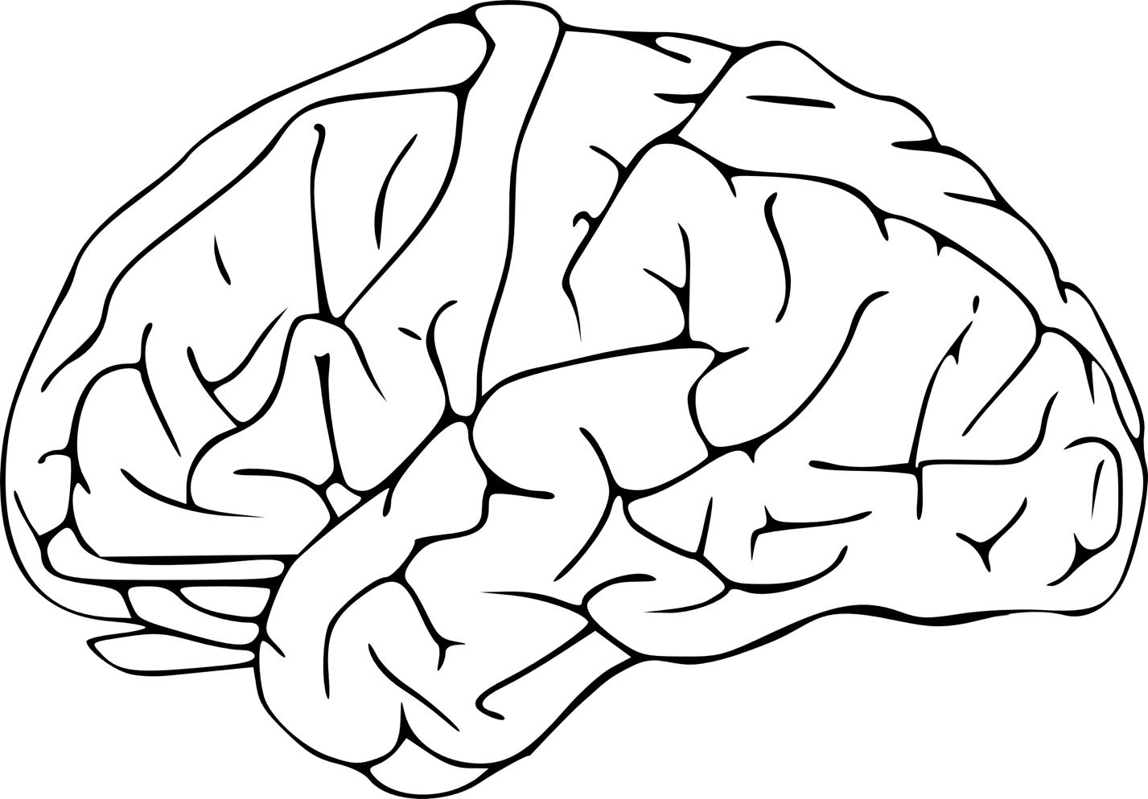
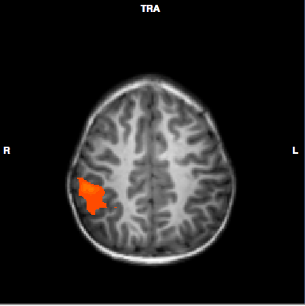
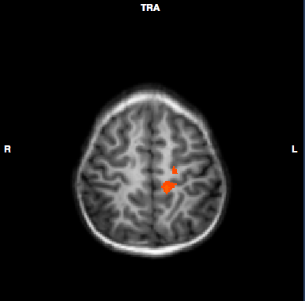
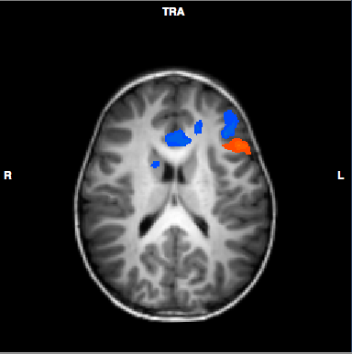
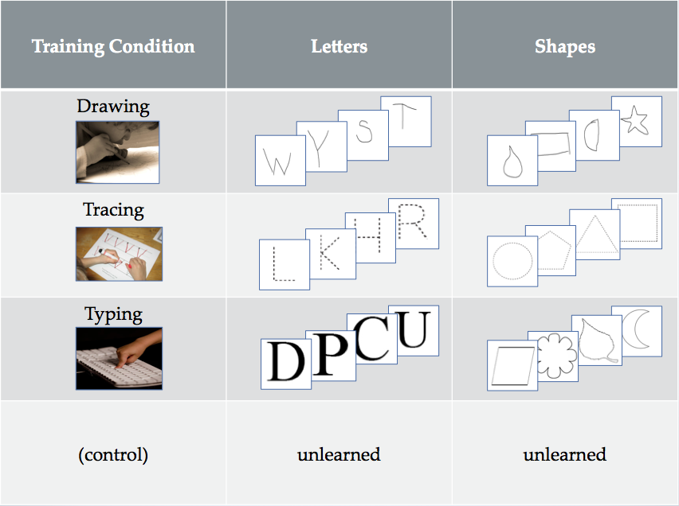
Investigating the development of letter perception using gPPI connectivity analysis
Vinci-Booher, S., Engelhardt, L., James, T.W., & James, K.H.
Department of Psychological and Brain sciences, Indiana university
Purpose
To investigate the effects of learning letters through handwriting on the development of a letter perception functional brain network.
Analysis
Preprocessing of fMRI images done in BrainVoyager QX.
Generalized Psychophysiological Interactions⁵ (gPPI)
analysis performed using average BOLD activity of the seed (R):
Y= β₀+ β₁X₁+ … + β₈X₈+β₁₀R+ β₁₁RX₁+ … +β₁₈RX₈+ε,
where β₁₁ through β₁₈ correspond to gPPI β-weights
for conditions 1 through 8.
Seed definition: Functionally localized
for each individual
using the contrast:
dLets+trLets+tyLets>3fixation.
Seeds chosen for L FuG and R FuG.
Background
Letter learning reinforced through handwriting (1) facilitates letter recognition¹ and (2) increases BOLD signal from L FuG during letter perception², when compared to visual-only letter learning.
Typical brain areas:
fusiform gyrus (FuG)
precentral gyrus (PrG)
inferior frontal gyrus (IFG)
middle frontal gyrus (MFG)
inferior parietal lobe (IPL)
cuneus
Monte Carlo simulations to cluster correct to p<0.05.
Child letter perception
after printing practice³:
Results & Conclusions
Child letter perception:
Adult letter perception⁴:
1: Practice
Learning letters through
any motor activity promotes an increase in
synchronous activity between
L FuG & R IPS/IPL and an
increase in synchronous activity between
R FuG & R cuneus during letter perception.
2: Printing experience
Learning letters through
printing promotes
an increase in
synchronous activity
between L FuG & L PrG and L PoG
during letter perception.
seed: L FuG (red); dLet > dSh
seed: R FuG (blue): dSh > dLet
seed: L FuG (red);
dLet+trLet +tyLet > cLet
seed: L FuG (red); dLet>tyLet
3: Stimulus form
Learning letters,
not shapes,
through printing
promotes an
increase in synchronous activity
between L FuG & L MFG/L IFG
during letter perception. Learning
shapes, not letters, through printing
promotes an increase in synchronous
activity between R FuG & L MFG and
ACC during shape perception.
R
R
R
z=43
z=53
z=18
L
L
L
Visuospatial
~practice
Sensorimotor
~printing experience
Other regions of interest: postcentral gyrus (PoG), intraparietal sulcus (IPS), anterior cingulate gyrus(ACC).
R IPS/IPL
R
L
L PrG
Methods³
Preliterate 5 y/o (56.6m, s.d.=4.02) children (n=11, 6 female).
R cuneus
L PoG
R ACC
L ACC
Premotor
~stimulus form
Training: Different sets of letters
and shapes were reinforced
through different manipulations
of the fine motor system.
fMRI session: Passively viewed
letters and shapes that were
learned through the different
training methods.
R
L MFG
Letters & shapes
R FuG
L FuG
L IFG
letters: solid line
shapes: dotted line
L
Letters
4:55
After handwriting practice, letter perception is supported by a set of visuospatial,
sensorimotor, and premotor areas that function synchronously with letter perception areas.
Type Shape
Trace
Letter
Draw
Shape
Trace
Shape
Type
Letter
Draw
Letter
Control
Letter
Control Shape
Discussion
Handwriting letters promotes neural characteristics indicative of maturing letter perception, such as functional connectivity between visual and motor regions and left lateralization.
Functional connections appear to reflect aspects of letter learning. Parietal involvement may be due to spatial processing, sensorimotor may be due to the use of motor plans, and premotor may be due to retrieval of letter form.
Future studies will investigate the neural correlates during letter writing in adults and preliterate children.
10s
1.0s
0.5s
24s
10s
24s
10s
¹ Longcamp et al., 2005; ² James, 2010; ³ James & Engelhardt, 2012; ⁴James & Gauthier, 2006; ⁵ McLaren et al., 2012.
This investigation was supported by the National Institute of Health, T32 Grant # HD 07475.
Thank you to members of the CAN lab, PAN lab, and the Psychology Writing Group!

