Slide 1
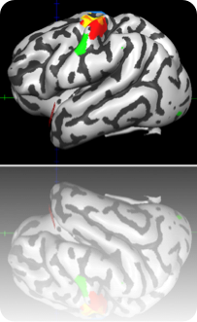
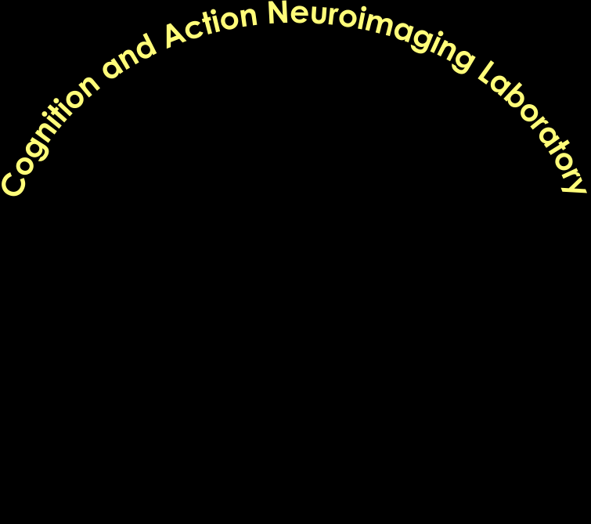
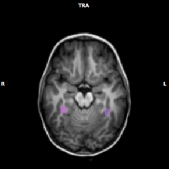
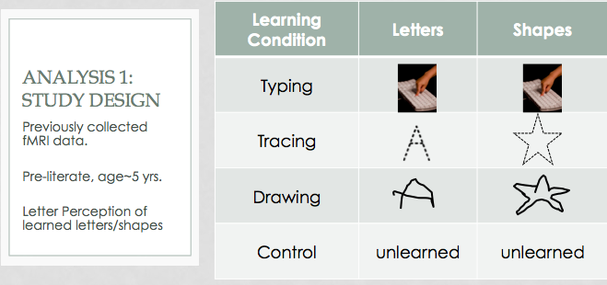
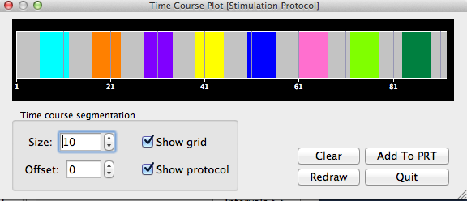
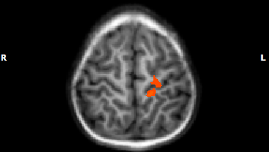
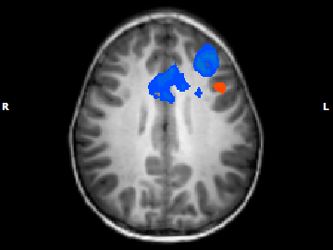
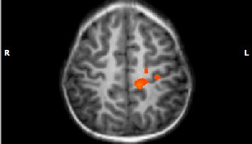
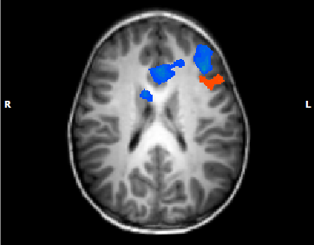
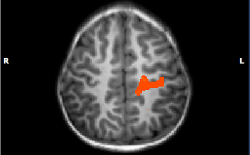
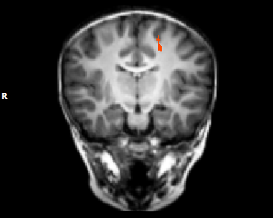
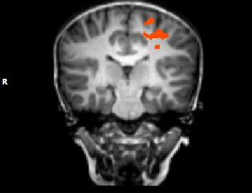
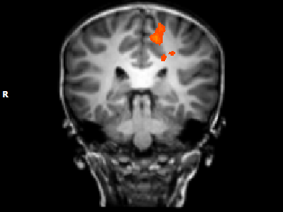
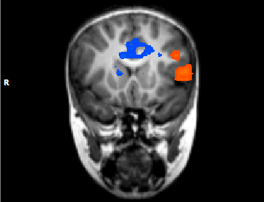
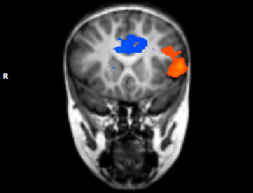
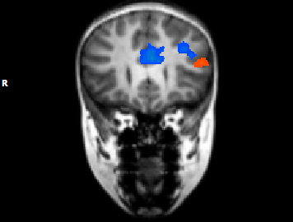
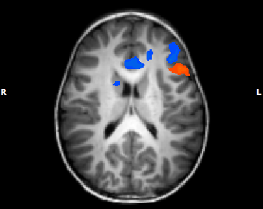
Investigating the development of letter perception using gPPI connectivity analysis
Vinci-Booher, S., Engelhardt, L., James, T.W., & James, K.H.
Department of Psychological and Brain sciences, Indiana university
Background
Letter learning reinforced through handwriting:
facilitates letter recognition¹,
increases BOLD signal from LFG during letter perception²,
when compared to visual-only letter learning.
Areas typically involved in adult letter perception: LFG, LPrG, LIFG, LMFG, and posterior parietal cortex³.
  Methods³
  Preliterate 5 y/o (56.6m, s.d.=4.02) children (n=11, 6 female).
Analysis
Generalized Psychophysiological
Interactions⁴ (gPPI) analysis done in Matlab R2012b.
Y= β₀+ β₁X₁+ … + β₉X₉+β₁₀R+ β₁₁RX₁+ … +β₁₉RX₉+ε,
where R= BOLD activity of the seed.
Monte Carlo simulations to cluster correct to p<0.05.
Functional individualized seeds:
allLetters>fixation (balanced)
RFG and LFG
Training: Different sets of letters
and shapes were reinforced
through different manipulations
of the fine motor system.
fMRI session: Viewed letters
and shapes that were learned
through the different training
methods.
4:55
Type Shape
Trace
Letter
Draw
Shape
Trace
Shape
Type
Letter
Draw
Letter
Control
Letter
Control Shape
Purpose
To investigate the effects of learning letters through handwriting on the development of a letter perception functional brain network.
Discussion
Handwriting letters promotes neural characteristics indicative of maturing letter perception, such as connectivity between visual and motor regions and left lateralization.
10s
1.0s
0.5s
24s
10s
24s
10s
Preprocessing of fMRI images done in BrainVoyager QX.
Results & Conclusions
Conclusion 1:
Learning letters through handwriting promotes
an increase in synchronous activity between
LFG & dorsal LPrG/LPoG during letter perception.
Conclusion 2:
Learning letters through handwriting promotes
an increase in synchronous activity between
LFG & LIFG/LMFG during letter perception, co-occurring
with an increase in synchronous activity between
RFG & LIFG/LMFG/ACC during shape perception.
z=28
z=22
z=18
z=58
z=40
z=46
y= -15 y= -24 y= -32
y= 14 y= 17 y= 25
seed: LFG (orange), contrast: ppiDrawLetters > ppiTypeLetters
seed: LFG (orange), contrast: ppiDrawLetters > ppiDrawShapes
seed: RFG (blue), contrast: pppiDrawShapes > ppiDrawLetters
LFG = left fusiform gyrus, RFG = right fusiform gyrus, LPrG = left precentral gyrus, LPoG = left postcentral gyrus,
LIFG = left inferior frontal gyrus, LMFG = left middle frontal gyrus, ACC = anterior cingulate cortex
¹ Longcamp et al., 2005; ² James, 2010; ³ James & Engelhardt, 2012; ⁴ McLaren et al., 2012

