Slide 1
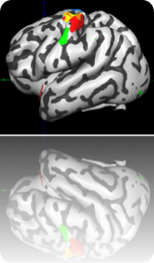
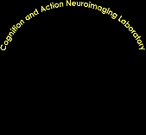
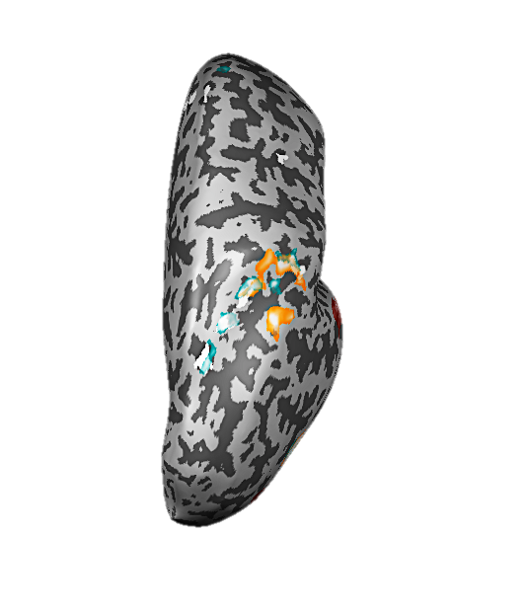
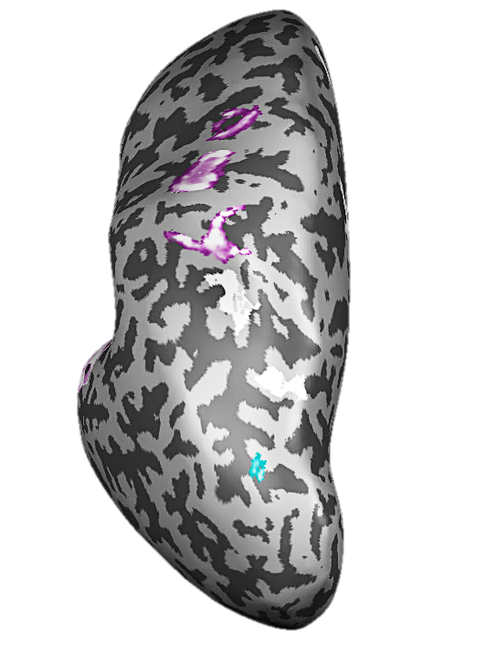
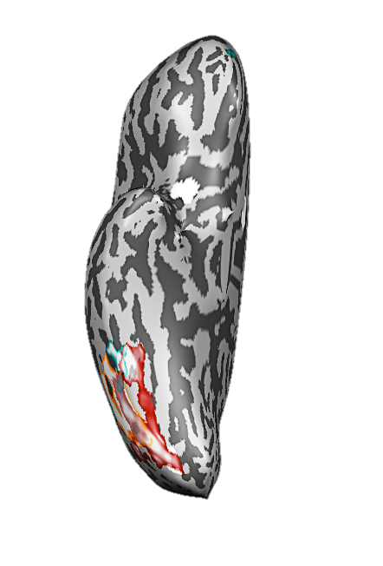
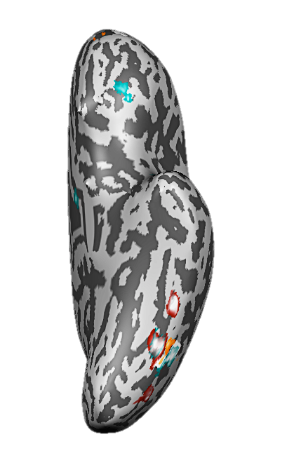


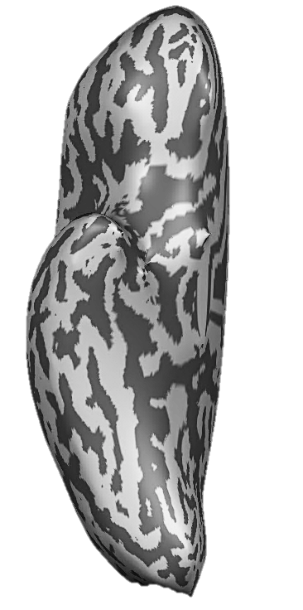
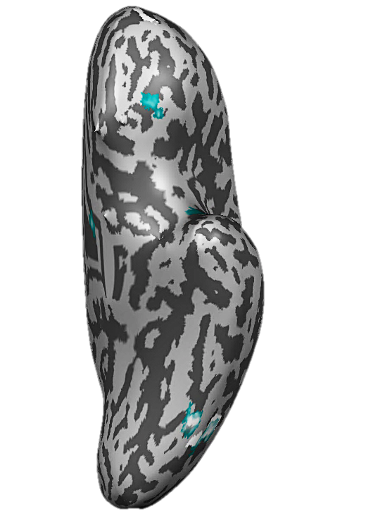












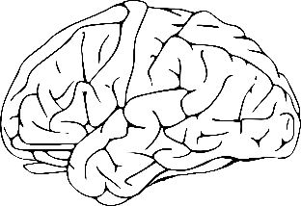
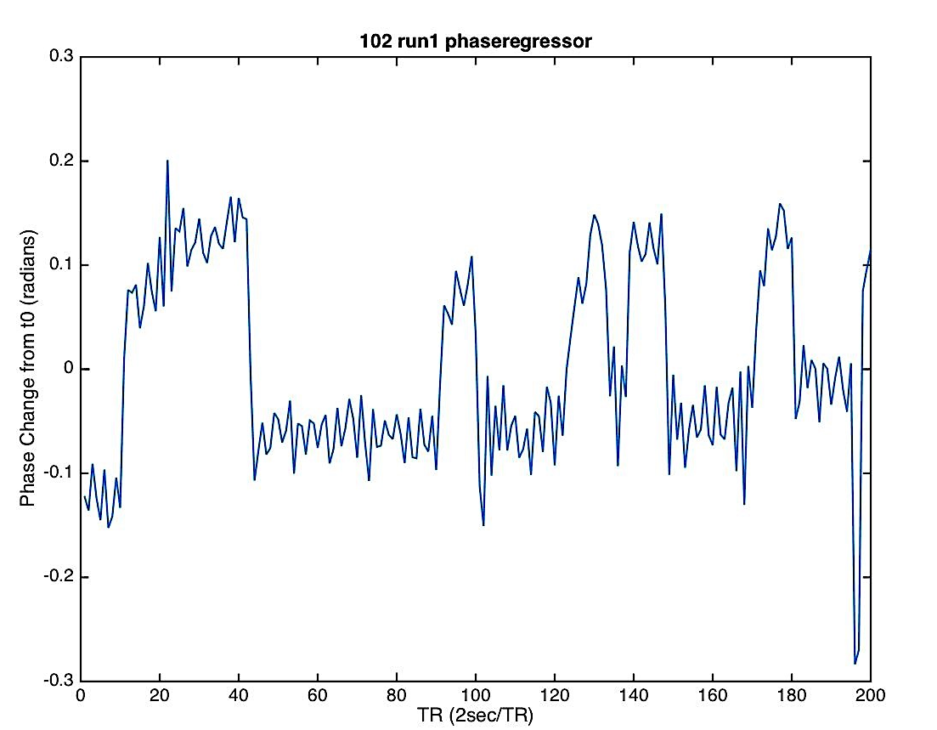
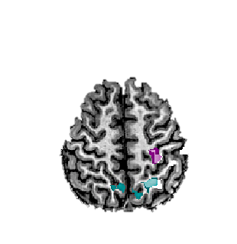
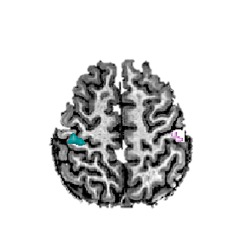
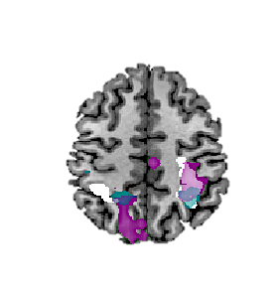
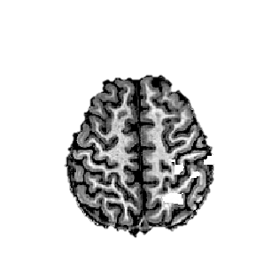
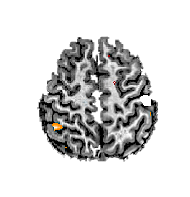
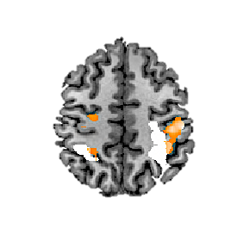
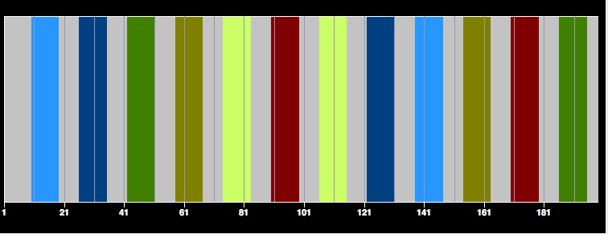
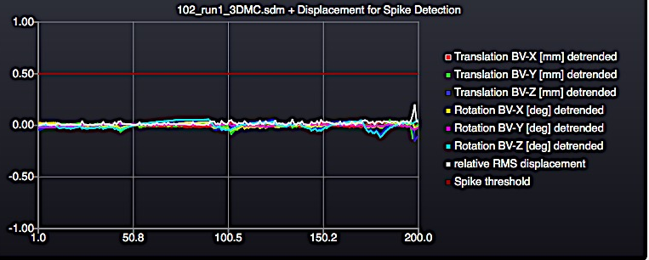
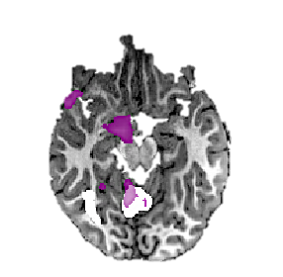
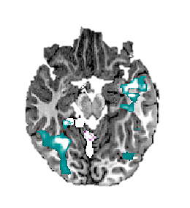
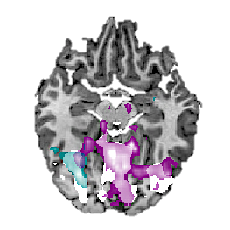
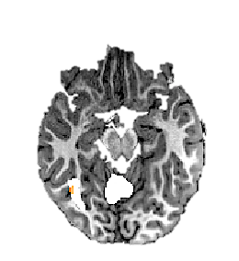
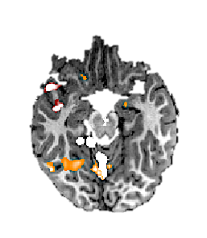
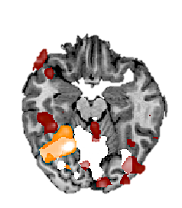
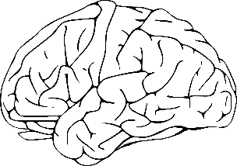
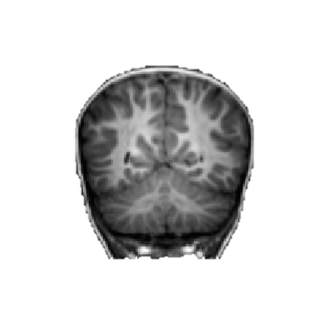
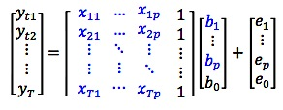
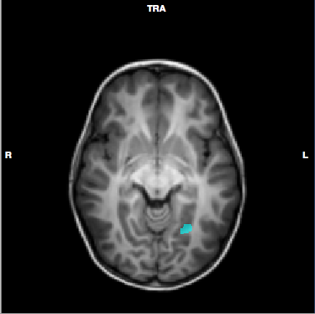
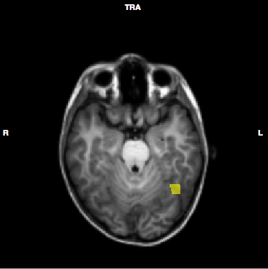
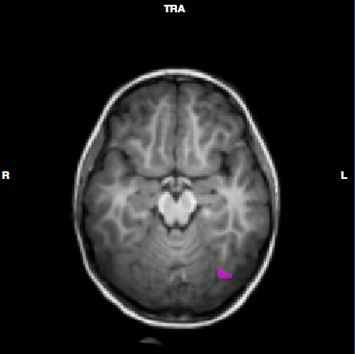
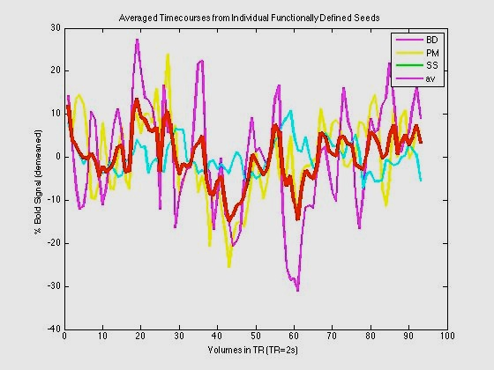
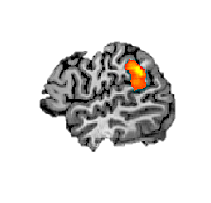
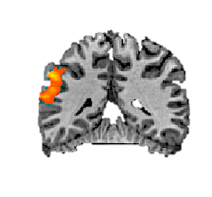
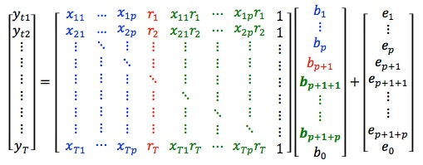
Handwriting as a visually guided action:
A developmental neuroimaging study
Vinci-Booher, S., Cheng, H., & James, K.H.
Psychological & Brain Sciences, Indiana University
Background
Methods
Study 1 Results
Letter recognition
is facilitated by:
… practice printing letters.¹
… studying variable fonts.²
Study Groups:
Study 1: literate adults
Study 2: pre-literate (5.5-6.5 yrs.), early-literate (6.5-7.5 yrs.), literate (adults)
L dPrG
L FuG – L IPS were more
functionally connected
while watching the letter unfold as they write it
than while writing the letter without ink.
Scanning Protocol
6:36
R SPL/IPS/IPL
Draw
Draw
Watch
Watch
Watch
L IPL
L dPrG – L IPL and L dPrG – R SPL were more
functionally connected
during letter writing than
while watching their handwritten letter unfold.
20s
4s
24s
14s
24s
14s
24s
14s
24s
14s
24s
14s
+
+
+
+
+
… a second set of
5 blocks with
different letters
Adults³
Print
Letters
(ink)
Print
Letters
(no ink)
Perceive
Letters
(own,
dynamic)
Perceive
Letters
(own,
static)
Perceive
Letters
(typed,
static)
L
letter perception
letter writing
Whole Brain Contrasts:
n = 6 adults, 3 male
RFX GLM, p_{vox} < .0001, p_{clust} < .001
Functional Connectivity:
n = 14 adults, 7 male
RFX GLM, p_{vox} < .01, p_{clust} < .01
L
L FuG
L FuG
TAL:
(-42, -50, -17)
Standard Preprocessing
Slice Scan Time Correction, 3D Motion Correction, Spatial Smoothing (FWHM =
6mm), Temporal High-pass Filtering
TAL:
(-37, -68, -10)
Study 2 Results
Additional Motion Correction
Spike Regression⁶: 0.05 mm threshold for adults
              2.00 mm threshold for children
Motion Regression⁷: 6 rigid-body motion parameters,
their temporal derivatives were
added in children
Phase Regression⁸: average change in
phase across slices
DURING LETTER WRITING
DURING PASSIVE VIEWING
Study 1: Do visual-motor connections support adult letter perception and writing?
D
D
T
D
D
T
Whole Brain Contrasts
(after printing practice)
Perceptual: Print Letters (ink) > Print Letters (no ink)
Children^{4,5}
Motor: Print Letters (ink) > Perceive Letters (own, dynamic)
L
L
Variability: Perceive Letters (own, static) > Perceive Letters (typed, static)
pre-literate (n=1)
p_{vox} < .001, uncorr.
early-literate (n=4)
p_{vox} < .05, clust. corr. at
50 voxels
literate (n=2)
p_{vox} < .05, clust. corr. at
50 voxels
pre-literate (n=1)
p_{vox} < .001, uncorr.
early-literate (n=4)
p_{vox} < .05, clust. corr. at
50 voxels
literate (n=2)
p_{vox} < .05, clust. corr. at
50 voxels
Letters: Perceive Letters (typed, static) > (implicit baseline)
Functional Connectivity Analysis (gPPI⁹)
Conclusions
References
Seeds defined individually:
  (1) PERFORM A GLM ANALYSIS
  Goal: Generate psychological predictors.
  (2) SELECT SEED VOXELS
  Goal: Generate physiological predictors.
Perceptual,
in L FuG
Motor,
in L dPrG
voxel-by-voxel GLMs
BD
261 voxels
PM
518 voxels
SS
190 voxels
R
Functional connections between visual and
motor brain regions support letter writing
in literate adults; however,
they appear to be mediated
by parietal cortex.
Pre-literate,
early-literate,
and literate adults
use different brain regions
during letter perception and during letter writing.
1. Longcamp, M., Zerbato-Poudou, M. T., & Velay, J. L. (2005). The influence of writing practice on letter recognition in preschool children: A comparison between handwriting and typing. Acta psychologica, 119(1), 67-79.
2. Li, J. X., & James, K. H. (2016). Handwriting Generates Variable Visual Output to Facilitate Symbol Learning. Journal of experimental psychology. General.
3. James, K. H., & Engelhardt, L. (2012). The effects of handwriting experience on functional brain development in pre-literate children. Trends in Neuroscience and Education, 1(1), 32-42.
4. Vinci-Booher, S., James, T.W., & James, K. H (2016). Functional connections during letter perception reflect aspects of letter writing: A gPPI functional connectivity study. Manuscript submitted.
5. Satterthwaite, T. D., Elliott, M. A., Gerraty, R. T., Ruparel, K., Loughead, J., Calkins, M. E., ... & Wolf, D. H. (2013). An improved framework for confound regression and filtering for control of motion artifact in the preprocessing of resting-state functional connectivity data. Neuroimage, 64, 240-256.
6. Bullmore, E. T., Brammer, M. J., Rabe-Hesketh, S., Curtis, V. A., Morris, R. G., Williams, S. C. R., ... & McGuire, P. K. (1999). Methods for diagnosis and treatment of stimulus-correlated motion in generic brain activation studies using fMRI. Human brain mapping, 7(1), 38-48.
7. Cheng, H., & Li, Y. (2010). Respiratory noise correction using phase information. Magnetic Resonance Imaging, 28(4), 574-582.
8. McLaren, D. G., Ries, M. L., Xu, G., & Johnson, S. C. (2012). A generalized form of context-dependent psychophysiological interactions (gPPI): a comparison to standard approaches. Neuroimage, 61(4), 1277-1286.
  (3) CREATE GPPI DESIGN MATRIX
  Goal: Generate psychophysiological predictors.
R IPS/IPL
Study 2: What brain regions are involved during letter writing at different stages of literacy?
Response Variable:
BOLD signal time
course for t=t1:T.
Error terms:
Error for each
time point, t=t1:T.
Perceptual
Contrast
with gPPI
predictors
Motor
Contrast
with gPPI
predictors
Psychological Predictors:
Predicted time courses
for each task,
1:p for t=t1:T.
correspond to
TASK on/off
convolved with
HRF
Physiological Predictors:
BOLD signal from seed
region for t=t1:T.
correspond to
SEED activity
Psychophysiological Predictors:
Element-wise multiplication of
Psychological and Physiological
predictors, 1:p for t=t1:T.
RFX ANCOVA, Two-Factor w/repeated measures on factor A
p_{vox} = 0.01, p_{clust} = 0.01
x, y, z = 51, -41, 30
  (4) PERFORM A SECOND GLM ANALYSIS
  USING THE GPPI DESIGN MATRIX.
  Goal: Determine task-dependent functional connectivity with the seed.
FUNDING: National Institute of Health, T32 Grant # HD 07475, IUB Imaging Research Facility Brain Scan Credit Program

