Slide 1
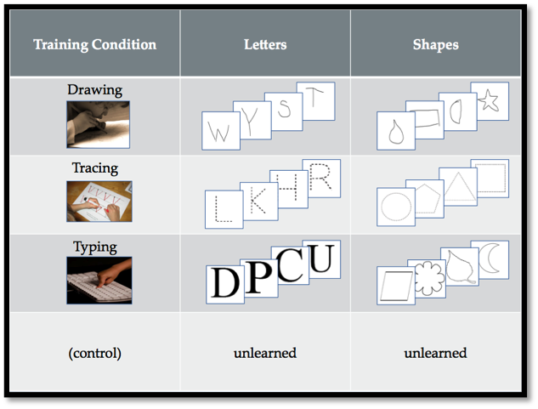
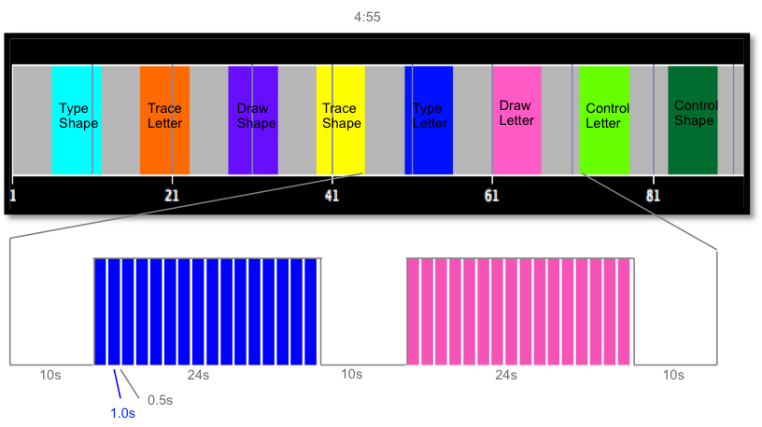
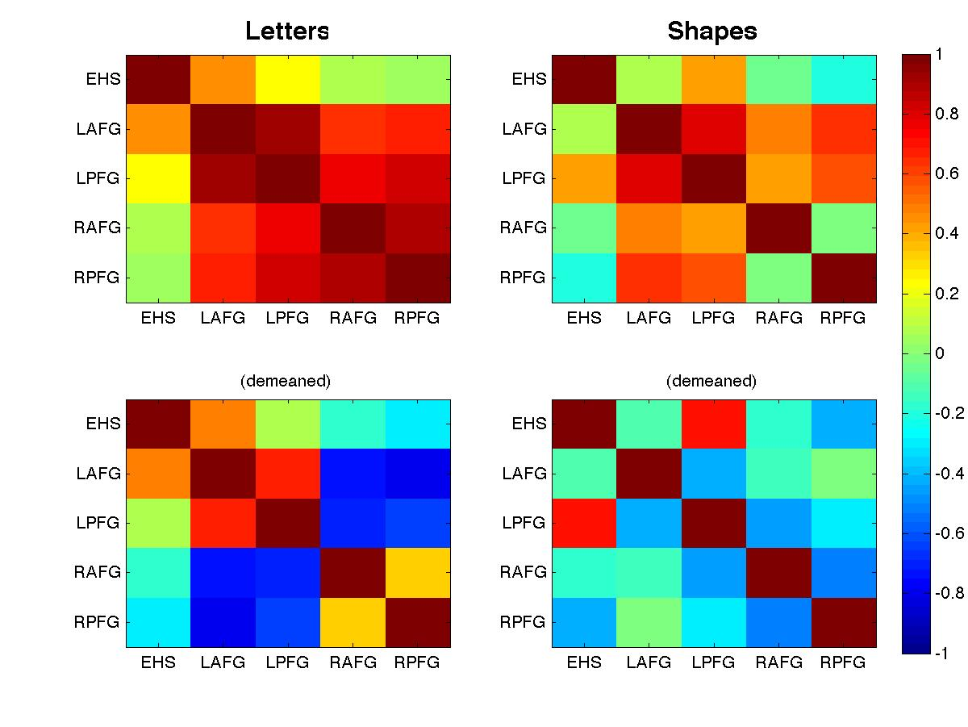
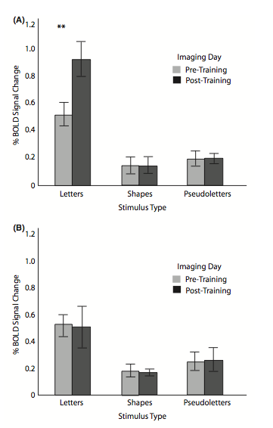
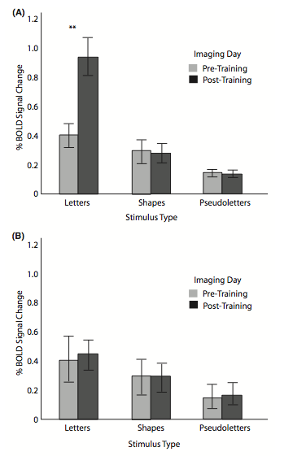
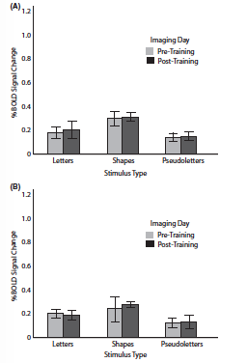
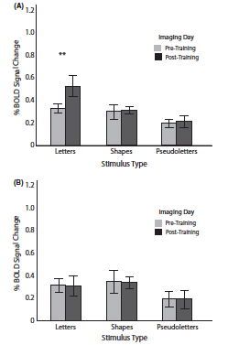
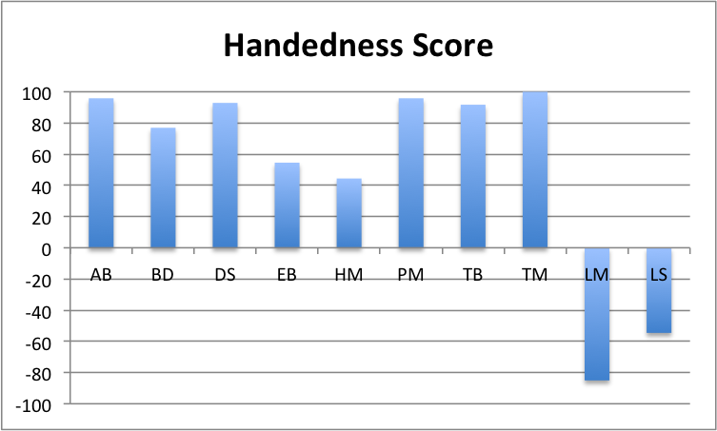
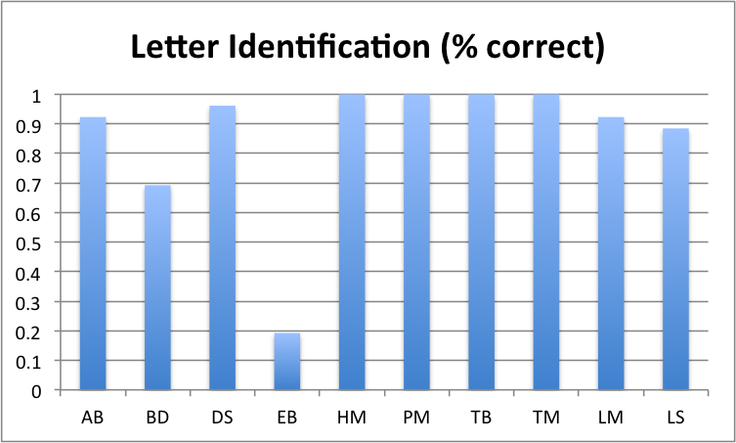
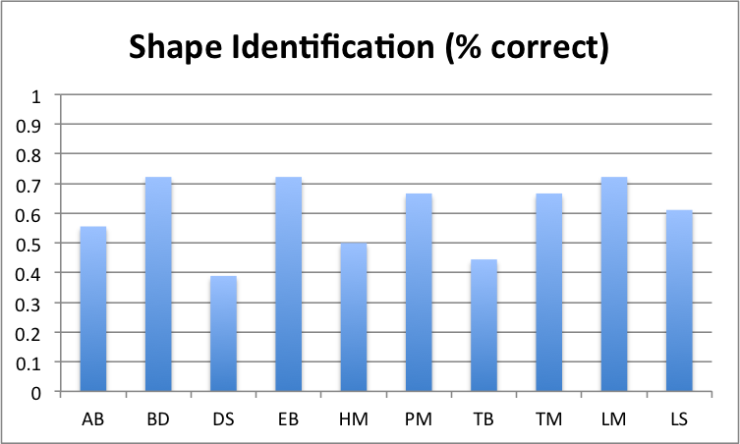
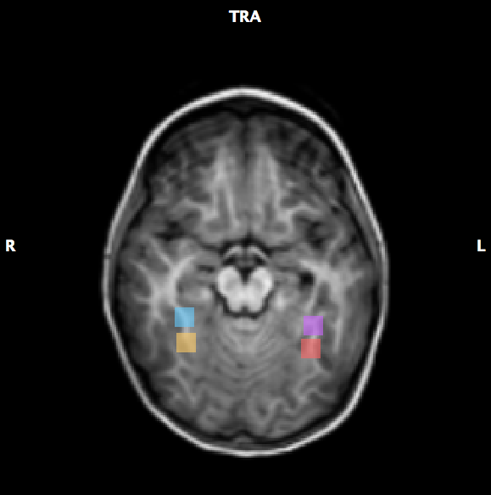
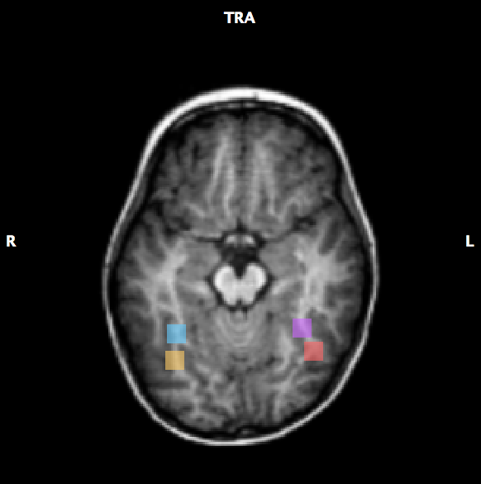
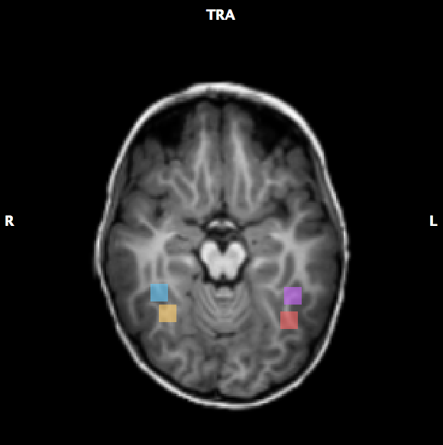
The Relationship Between Handedness and Activation in the Visual Cortex of the Brain
Sehgal, N., Vinci-Booher, S., & James, K.H.
Department of Psychological and Brain Sciences, Indiana University Bloomington
Cognition and Action Neuroimaging Laboratory
Background
Study Design⁴
Results & Conclusions
Motor: Right-handers showed increased activation in left motor areas after handwriting experience; left-handers showed increased activation in right-hemisphere homologue¹.
Visual: Right-handers show increased activation from the left fusiform gyrus after handwriting experience².
Asymmetrical weight of right and left hemispheres is possibly related to handedness³.
LAFG
Left Anterior
Fusiform Gyrus
LPFG
Left Posterior
Fusiform Gyrus
RAFG
Right Anterior
Fusiform Gyrus
RPFG
Right Posterior
Fusiform Gyrus
Sensorimotor Training
Collapsed across letter conditions and shape conditions (letter vs. shape)
Functional magnetic resonance imaging (fMRI) conditions
Standardized data (raw and demeaned)
LAFG and LPFG are highly correlated with each other RAFG and RPFG are highly correlated with each other
LAFG/LPFG correlated with RAFG/RPFG in raw correlations LAFG/LPFG anti-correlated with RAFG/RPFG in demeaned correlations
EHS is more positively correlated with LAFG/LPFG EHS is more negatively correlated with RAFG/RPFG
LAFG has the highest positive correlation with EHS
Correlations with EHS were stronger for letters than shapes in general
Visual Training
Analysis
1) Analyzed subject characteristics
Sample size: n=10
Average age: 56.2 months
St. dev: 3.54 months
Hypotheses
Indicates a role for neural efficiency as a developmental mechanism and displays the importance of action in the development of perception.
Handedness scores will show stronger correlations with activity in all 4 perceptual areas (LAFG, LPFG, RAFG, RPFG) for letters than shapes.
It is also expected that the Edinburgh Handedness Scores (EHS) will be positively correlated with the LAFG/LPFG and negatively correlated with the RAFG/RPFG.
2) Extracted ROI time course data anatomically located on each individual
References
¹Longcamp, M., Zerbato-Poudou, M. T., & Velay, J. L. (2005). The influence of writing practice on letter recognition in preschool children: A comparison between handwriting and typing. Acta psychologica, 119(1), 67-79.
²James, K. H. (2010). Sensori‐motor experience leads to changes in visual processing in the developing brain. Developmental science, 13(2), 279-288.
³Behrmann, M., Plaut, D.C. (2013). Distributed circuits, not circumscribed centers, mediate visual recognition. Trends in Cognitive Sciences, 1-10.
⁴James, K. H., & Engelhardt, L. (2012). The effects of handwriting experience on functional brain development in pre-literate children. Trends in Neuroscience and Education, 1(1), 32-42.
Subject AB
Subject DS
Subject LS
3) Performed Pearson correlations between EHS and all 4 ROIs & all 4 ROIs with each other

