Slide 1
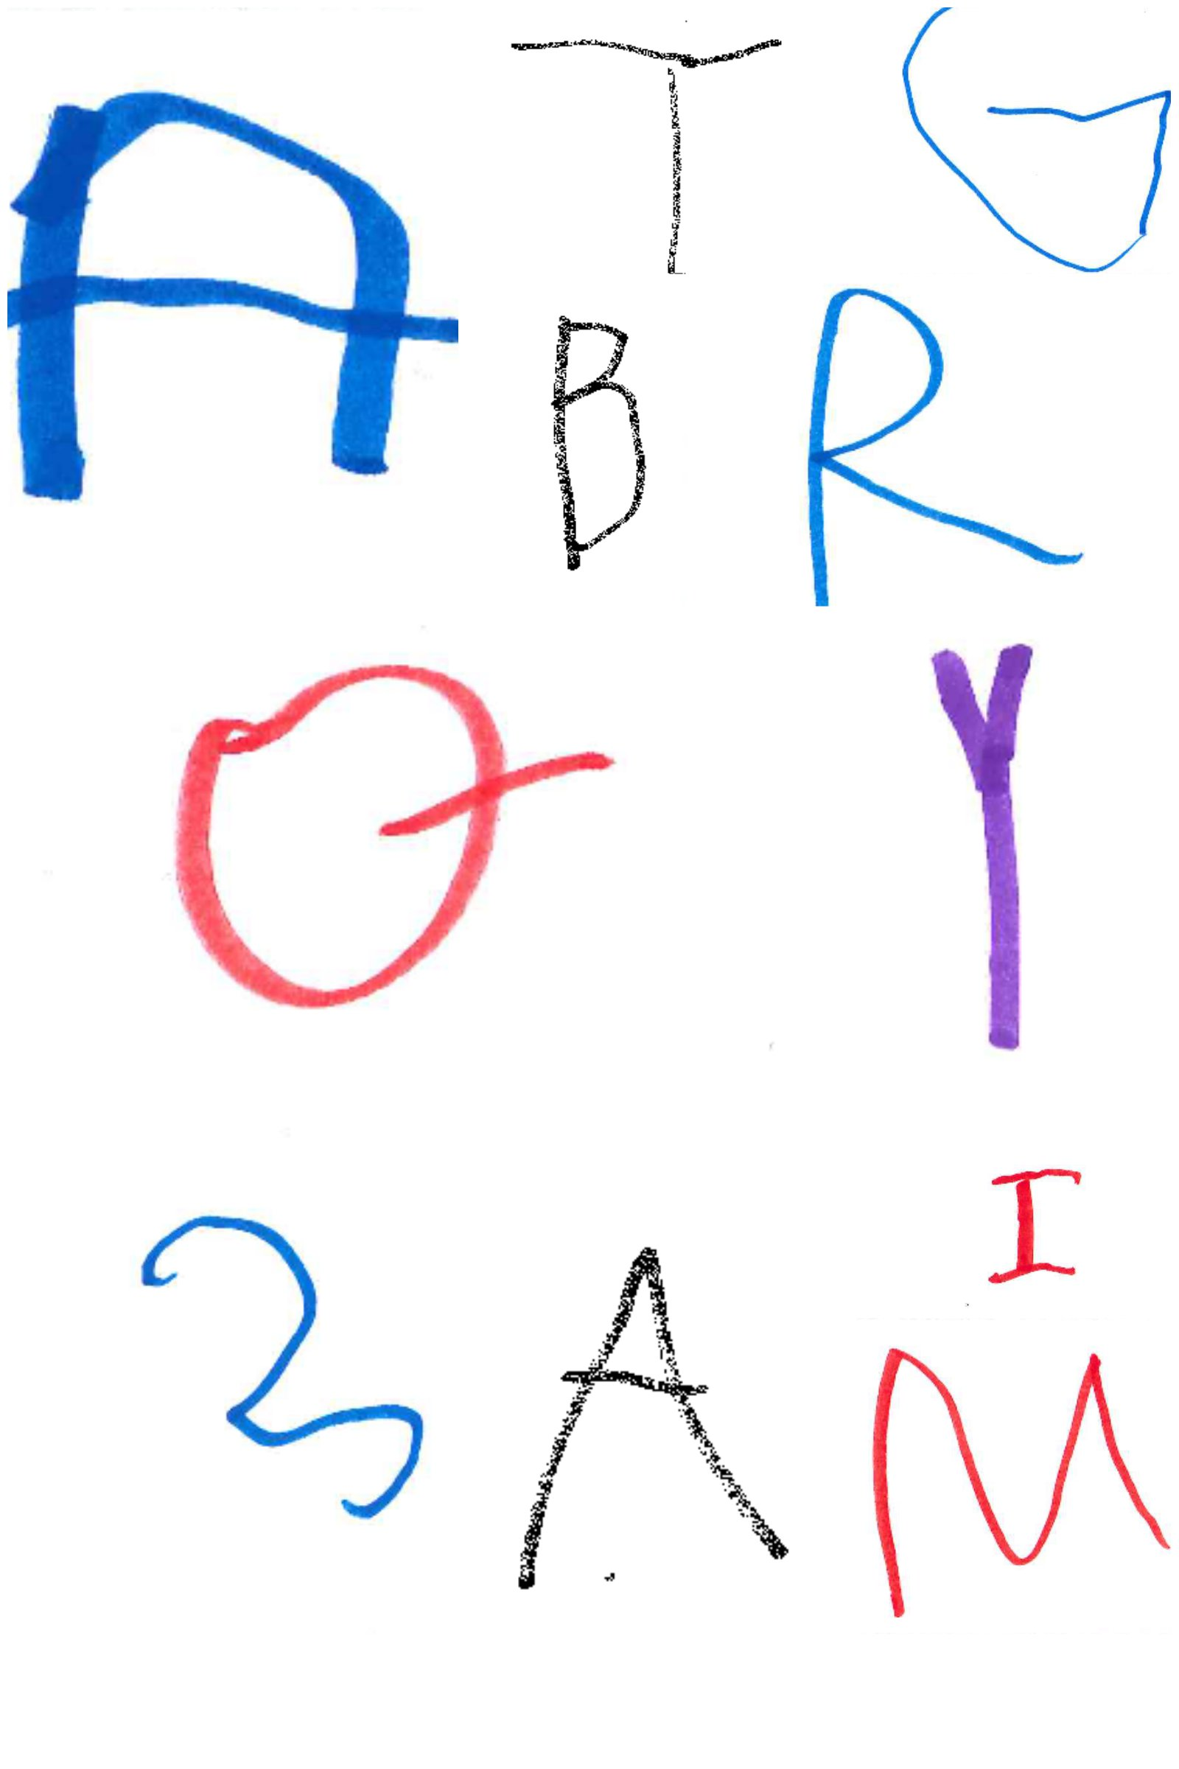
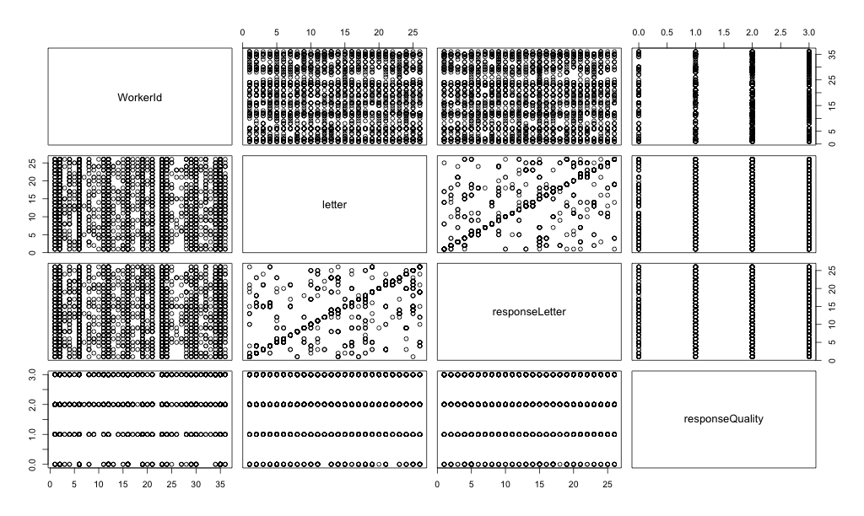
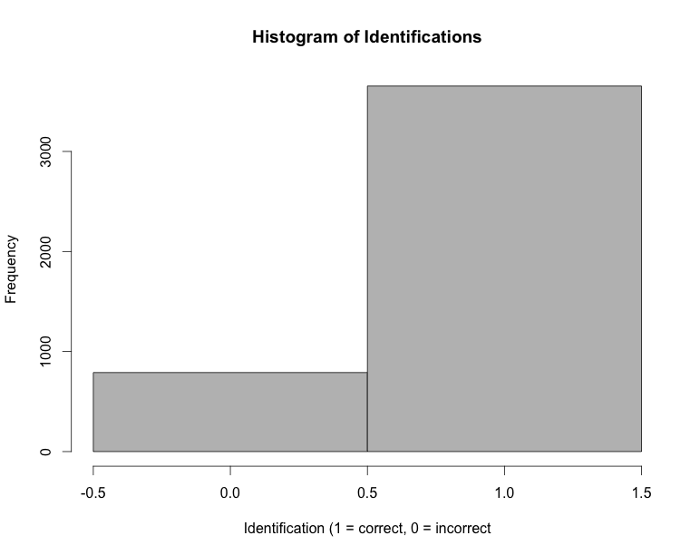
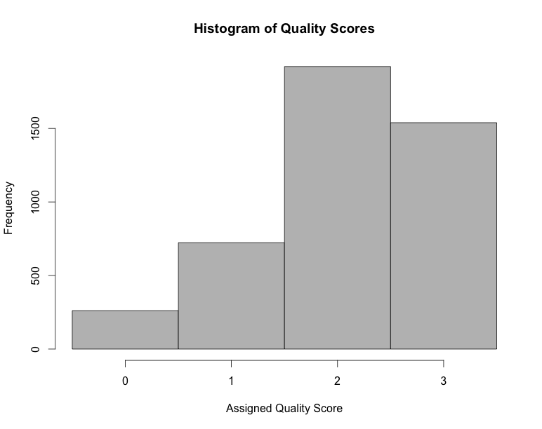
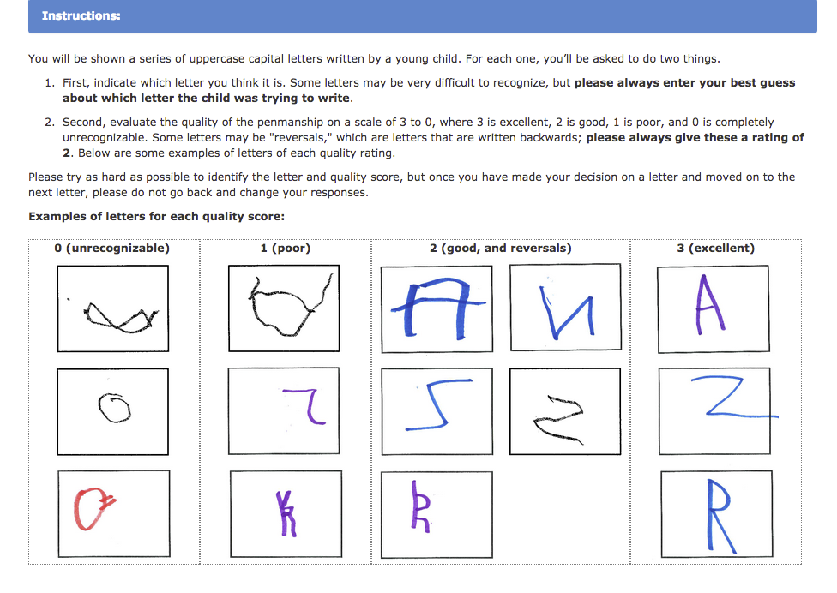
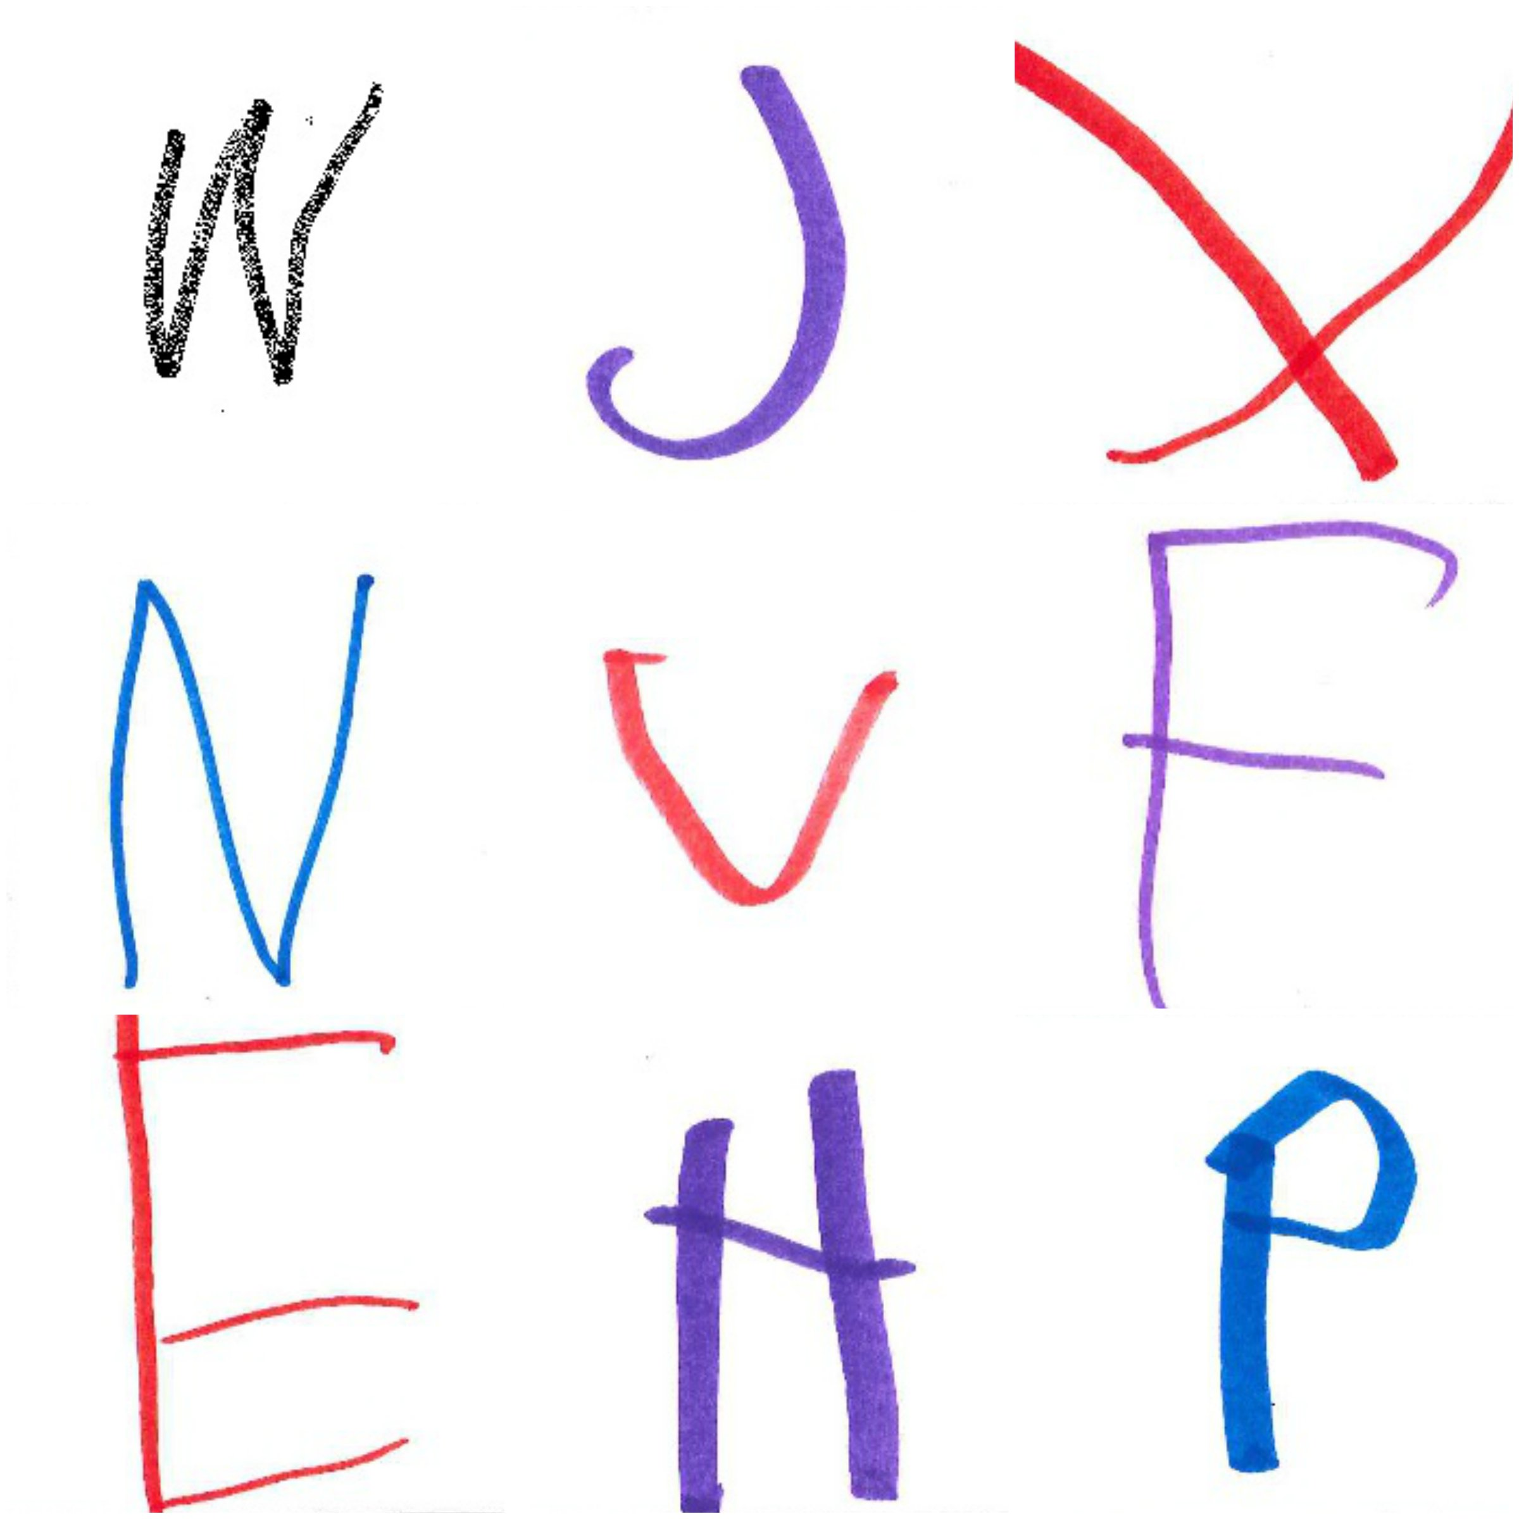
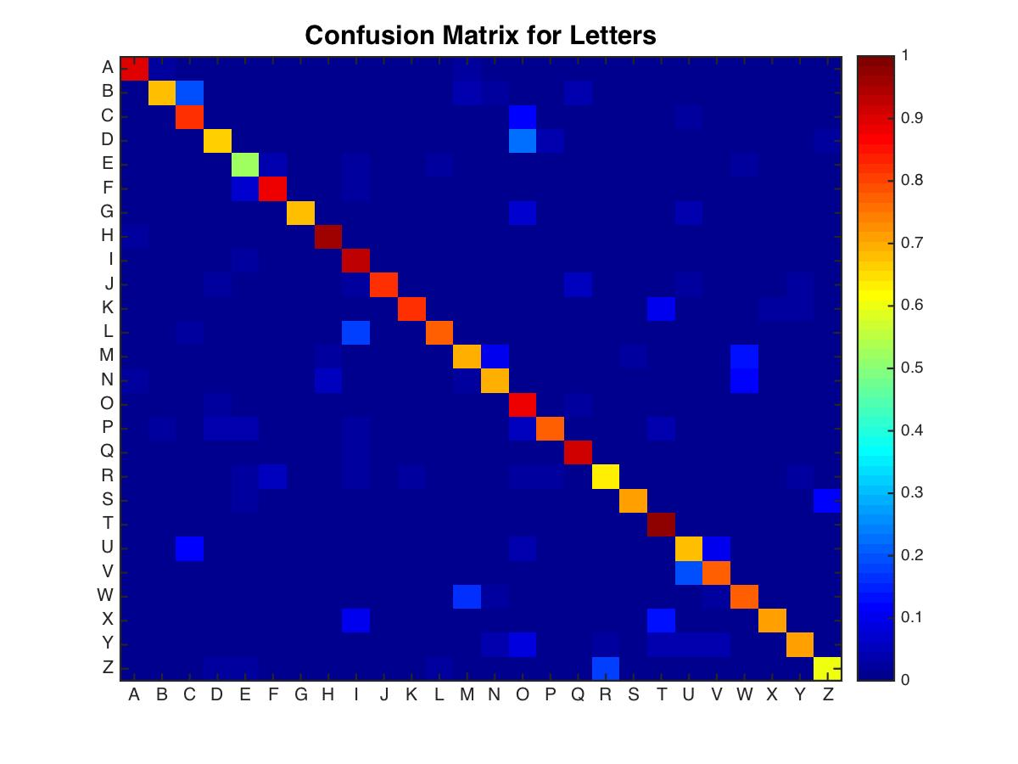
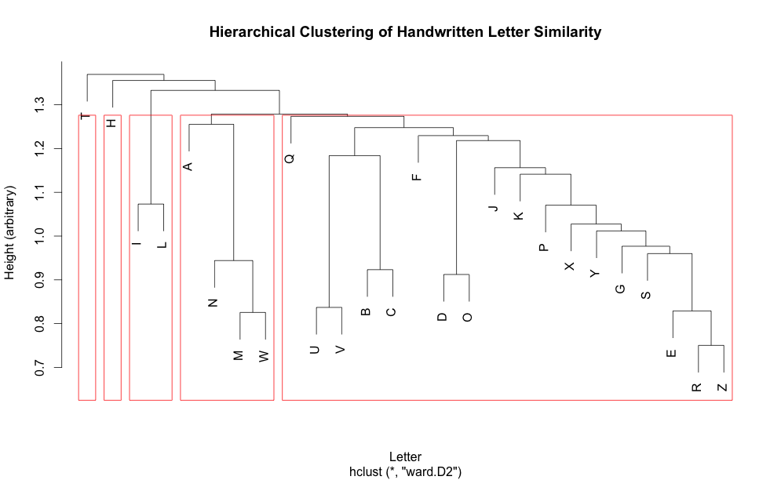
Exploring Automated Techniques for Identifying and Scoring Children’s Handwriting Samples
Tayla Frizell (Mississippi Valley State University), Sophia Vinci-Booher (Indiana University), Deborah Zemlock (Indiana University)
Mentor: David Crandall, PhD (Indiana University), 107 S Indiana Ave, Bloomington, IN 47405
Abstract
An important part of child development is learning how to write. No one quite understands how this process occurs and how it correlates with their motor development and reading abilities (Longcamp et al. , 2013). In order to enhance the understanding of handwriting and its correlations, handwriting samples were collected from a diverse group of children so that it may be scored, analyzed, and compared. To score these hand writing samples multiple automatic and semi-automatic methods were researched. The method we chose was Amazon Mechanical Turk (MTurk). MTurk allows an online crowd to perform unbiased labeling and scoring of the collected letter samples. Initial results indicate that this may be a viable method of scoring handwritten letters, with some limitations. As a continuation of this study, shorter viewing durations of the letter samples would improve interpretability of the data (Gilmore et al. , 1967). Consequently, using the MTurk technique could improve how scientists and psychologists collect, score, and analyze handwriting samples.
Analysis
Histograms were generated in order to get effective visualization of the data provided by coders. Fleiss’ Kappa was then calculated utilizing a subset of the data to evaluate inter-rater reliability.
A confusion matrix was constructed using the letter identification provided by the coders and was then compared to a traditional letter perception study.
To better visualize the letter confusion, a dendogram was generated using hierarchical clustering analysis based on Euclidean distances.
Summary
The histograms identify the distribution of letter identification and quality scores.
most often letters were identified correctly and there was high inter-rater reliability
quality scores were distributed from 0 – 3 without bias and there was low inter-rater reliability
The confusion matrix is a representation of which letters were mistaken for each other and how likely it may occur.
low variability because of the high rate of correct identification leaves little to be interpreted
the most highly confused letters in the Gilmore paper differ from the most highly confused letters in this study , indicating that the confusion lies in the construction of the letter by the child as opposed to the perception of the letter by the coder
The dendogram displays confusable letter clusters in a hierarchical fashion.
the I and L cluster may reflect misinterpretation of the letter to be drawn
the A,N,M and W cluster may reflect difficulty in producing diagonal lines
the letters in the tighter clusters closely resemble each other
Results
Methodology
Handwriting samples were collected from twenty-one students that ranged in age from 3 to 5 year olds from Saint Charles Catholic School and The Prep School located in Bloomington, IN. Each week for several weeks, the students completed worksheets that assessed their handwriting for 13 letters or numbers. The worksheets were then scanned and converted into PDF files that were later divided by a custom script.
Initial steps consisted of investigating various ways of efficiently scoring the handwriting samples.
Automatic Recognition using Convolutional Neural Networks
Image Processing to Extract Low-Level Visual Features
Amazon Mechanical Turk (Mason & Suri , 2011)
After investigating these possibilities and weighing the advantages versus the disadvantages with the consideration of time and high quality data, designing a Human Intelligent Task (HIT) on Amazon Mechanical Turk (MTurk) was the final decision. The task was designed to display random handwriting samples and ask multiple individuals to identify and score the quality of the letter using the following scale: 0 (unidentifiable), 1 (poor), 2 (good), and 3 (excellent).
Future Work
The long term goal is to develop an automatic scanning and scoring system for the Indiana University Psychology Department.
This project will be continued in hopes of developing an automated method of scoring handwriting samples collected from children in the Indiana school district.
References
Gilmore, G.C.; Hersh, H.; Caramazza, A.; Griffin, J. Multidimensional letter similarity derived from recognition errors, (1967)
Longcamp, M., Zerbato-Poudou, M. T., & Velay, J. L. (2005). The influence of writing practice on letter recognition in preschool children: A comparison between handwriting and typing. Acta psychologica, 119(1), 67-79.
Mason, Winter & Suri, Siddharth Conducting behavioral research on Amazon’s Mechanical Turk , (2011)
Incorrect Correct
81% of the letters were labeled correctly by the coders.
The Fleiss’ Kappa is 0.946.
The median and modes of the quality score are 2 and the distribution is acceptable.
Fleiss‘ Kappa is 0.143.
Acknowledgements
I would like to give special thanks to the Indiana University – Summer Research Opportunities in Computing (IU- SROC), Dr. David Crandall, and St. Charles Catholic School and The Prep School of Bloomington, IN.
This project was funded by the National Science Foundation (through CAREER IIS- 1253549) and the National Institutes of Health (T32 HD 07475.
Notes:
Abstract:
-”To score these hand writing samples multiple automatic…,” can be rearranged and merged with the following sentence so that it is not repetitive, “In order to enhance the understanding of handwriting and its correlations, handwriting samples, collected from a diverse group of children, were scored using multiple automatic and semi-automatic methods, analyzed, and compared.”
-” The method we chose was Amazon Mechanical Tu”…can change to…”The team selected the Amazon Mechanical … for the research study”
-” MTurk allowed an online crowd to perform unbiased labeling and scoring of the collected letter samples. ”…can be…”MTurk allows …..scoring of collected letter samples.”
-”As a continuation of this study…” are you referring to MTurk here or Longcamp et al, you may want to specify
-” As a continuation of this study, shorter viewing durations of the letter samples would improve interpretability of the data (Gilmore et al. , 1967). ”…can be changed to say…”letter samples have shown to improve interpretability of data” –be careful here: are you saying child interpretability of data? Is the data you’re referring to the handwriting sample data? You may want to specify so that this sentence is more clear for your readers
-Last sentence, “Consequently, using ______’s technique (are you referencing a certain technique if not don’t worry about the blank) can improve how… ”
Methodology:
-” Handwriting samples from twenty-one “..to..”Handwriting samples were derived (or taken, whichever floats your boat lol)
-” then scanned into PDF files that were divided by a custom script. ”…to…”scanned and converted into PDF files that were later divided…”
-” We began by investigating various ways of efficiently scoring the handwriting samples..”…to…”Initial steps involved (or consisted of) investing various methods for ….scoring the children’s handwriting…”
-” After investigating these possibilities and weighing the advantages versus the disadvantages with the consideration of time and high quality data, designing a Human Intelligent Task (HIT) on Amazon Mechanical Turk (MTurk) was the final decision (what do you mean by this? Was this your final chosen technique for carrying out the scoring process? Specify). The task was designed to display random handwriting samples and ask multiple individuals (include “to”) identify and score the quality of the (replace “the” with “a”) letter using the following scale: 0 (unidentifiable), 1 (poor), 2 (good), (include “and”) 3 (excellent). ”
Analysis: (you better go off with these big graph words I don’t know!)
-”Histograms were created (replace “created” with “generated”) to get a (replace “to get a better” with “in order to produce effective”) better visualization of the data provided by coders. Fleiss’ Kappa was then calculated on a (replace “on a” with “utilizing a”) subset of the data to evaluate inter-rater reliability. “
Summary:
-Replace “Most of the time ” with “Most often”
-Watch capitalization on bullet points
-”The confusion matrix is a representation of which letters were mistaken for each other and how likely it is to happen.” with “and how likely such an instance can occur”
-In this section, watch your spacing and bullet type (notice how in your Methodology you have used circle bullets, but here you have used square bullets)
Acknowledgements:
-Spell out IU-SROC and include IU-SROC in parenthesis after you spell it out
-Lastly, “, Dr. David Crandall, and (take this and out) St. Charles Catholic School and The Prep School of Bloomington, IN. ”
Other than that, Check your font for your section headers, they appear to be different and adjust the spacing of your second column to the left so that it is balanced. Very cool study and cool poster☺

